Slide 1
Writing Persuasive Messages

Slide 2
Using the Three-Step Process for Persuasive Messages
Apply the three-step writing process to persuasive messages.
Notes:
Whether you’re convincing your boss to open a new office in Europe or encouraging potential customers to try your products, you’ll use many of the same techniques of persuasion—the attempt to change an audience’s attitudes, beliefs, or actions. Successful professionals understand that persuasion is not about trickery or getting people to act against their own best interests; it’s about letting audiences know they have choices and presenting your offering in the best possible light.

Slide 3
Step 1: Planning Persuasive Messages
Analyze the Situation
Gather the Information
Select the Medium
Organize the Message
Notes:
In today’s business environment, having a great idea or a great product is no longer enough. Every day, untold numbers of good ideas go unnoticed and good products go unsold, simply because the messages meant to promote them aren’t compelling enough to be heard above the competitive noise.
Creating successful persuasive messages demands careful attention to all four tasks in the planning step, starting with an insightful analysis of your purpose and your audience.

Slide 4
Analyzing the Situation
Gauging Audience Desires and Interests
Demographic Information
Psychographic Information
Audience’s Level of Motivation
Notes:
A clear purpose is important in every message, but it is even more important in persuasive messages because you are asking the audience to do something. In defining your purpose, make sure you’re clear about what you really hope to achieve.
The best persuasive messages are closely connected to your audience’s desires and interests. To understand and categorize audience needs, you can refer to specific information such as demographics (age, gender, occupation, income, education, and other quantifiable characteristics) and psychographics (personality, attitudes, lifestyle, and other psychological characteristics).
If you aim to change someone’s attitudes, beliefs, or actions, you must understand his or her motivation—the combination of forces that drive people to satisfy their needs. The more closely a persuasive message aligns with a recipient’s existing motivation, the more effective the message is likely to be.

Slide 5
Gathering Information
Persuasive and Compelling
Business Messages
Marketing Messages
Sales Messages
Notes:
Once your situation analysis is complete, you need to gather the information necessary to create a compelling persuasive message. You’ll learn more about the types of information to include for persuasive business messages and marketing and sales messages later in this chapter. Chapter 11 presents advice on how to find the information you need.

Slide 6
Selecting the Right Combination of Medium and Channel
Nature of Persuasive Messages
Range of Consumer Attitudes
Variety of Communication Media
Notes:
Media and channel choices are always important, of course, but these decisions are particularly sensitive with persuasive messages because such messages are often unexpected or even unwelcome. For instance, some people don’t mind promotional email messages for products they’re interested in; others resent every piece of commercial email they receive.
Persuasive messages can be found in virtually every communication medium, from instant messages and podcasts to radio advertisements and skywriting. In fact, advertising agencies employ media specialists whose only jobs are to analyze the media options available and select the most cost-effective combination for each client and each advertising campaign.

Slide 7
Organizing Your Information
The Direct or the Indirect Approach?
What Is Your Relationship with the Audience?
What Is the Extent of Your Power, Authority, or Expertise?
Notes:
The nature of persuasion is to convince your audience to change their attitudes, beliefs, or actions, so most persuasive messages use an indirect approach. In contrast, when you have a close relationship with your audience, and the message is welcome or neutral, a direct approach can be effective.
Your choice between the direct and indirect approaches is also influenced by the extent of your authority, expertise, or power in an organization. Think carefully about your corporate culture and what your audience expects before selecting your approach.

Slide 8
Step 2: Writing Persuasive Messages
Use Positive and Polite Language
Respect Cultural Differences
Understand Culture
in Organizations
Establish Your Credibility
Notes:
The generally uninvited and occasionally even unwelcome nature of persuasive messages means the "you" attitude is more critical than ever. Most people won't even pay attention to your message, much less respond to it, if it isn’t about them. You can encourage a more welcome reception by doing the following:
Using positive and polite language. Positive language usually happens naturally with persuasive messages because you are promoting an idea or a product you believe in.
Understanding and respecting cultural differences. Be sure to understand cultural expectations. For example, a message that seems forthright and direct in a low-context culture might seem brash and intrusive in a high-context culture.
Being sensitive to organizational cultures. Just as social culture affects the success of a persuasive message, so too does the culture within various organizations. Some organizations handle disagreement and conflict in an indirect, behind-the-scenes way, whereas others accept and even encourage open discussion and sharing of differing viewpoints.
Taking steps to establish your credibility. You can boost your credibility by using simple language, providing objective evidence, identifying your sources, finding common ground, being fair and logical, and showing that you have your audience’s best interests at heart.

Slide 9
Building Your Credibility
Providing Objective Evidence
Identifying Your Source Materials
Focusing on the Audience’s Interests
Establishing Common Ground
Notes:
Finally, when you are trying to persuade a skeptical or hostile audience, credibility is essential. Use these techniques:
Use simple language to avoid suspicions of fantastic claims and emotional manipulation.
Provide objective evidence for the claims and promises you make.
Identify your sources, especially if your audience already respects those sources.
Establish common ground by emphasizing beliefs, attitudes, and background experiences you have in common with the audience.
Be objective and present fair and logical arguments.
Display your willingness to keep your audience’s best interests at heart.
Persuade with logic, evidence, and compelling narratives, rather than trying to coerce with high-pressure, “hard sell” tactics.
Whenever possible, try to build your credibility before you present a major proposal or ask for a major decision. That way, audiences don’t have to evaluate both you and your message at the same time.

Slide 10
Step 3: Completing Persuasive Messages
Evaluate Your Content
Produce Your Message
Proofread Your Message
Distribute Your Message
Notes:
Professionals know that details can make or break a persuasive message, so they don’t skimp on this part of the writing process. When you evaluate your content, judge your argument objectively and don’t overestimate your credibility. If possible, ask an experienced colleague who knows your audience well to review your draft.
As you produce your message, make sure your design elements complement your argument. Meticulous proofreading will identify mechanical or spelling errors that would weaken your persuasive potential. Finally, make sure your distribution methods fit your audience’s expectations, as well as your purpose.

Slide 11
Developing Persuasive Business Messages
Describe an effective strategy for developing persuasive business messages, and identify the three most common categories of persuasive business messages.
Notes:
Your success as a businessperson is closely tied to your ability to encourage others to accept new ideas, change old habits, or act on your recommendations. Unless your career takes you into marketing and sales, most of your persuasive messages will be designed to elicit a preferred response in a non-sales situation. Within the context of the three-step process, effective persuasion involves four essential strategies: framing your arguments, balancing emotional and logical appeals, reinforcing your position, and anticipating objections.

Slide 12
Framing Your Arguments (the AIDA Model)
Attention
Catch the Audience’s Attention
Interest
Provide Additional Details or Benefits
Desire
Explain Benefits; Address Objections
Action
Suggest Specific Audience Action
Notes:
Many persuasive messages follow some variation of the indirect approach. One of the most commonly used variations is called the AIDA model, which organizes your presentation into four phases:
Attention. Your first objective is to encourage your audience to want to hear about your problem, idea, or new product—whatever your main idea is. Be sure to find some common ground on which to build your case.
Interest. Provide additional details that prompt audience members to imagine how the solution might benefit them.
Desire. Help audience members embrace your idea by explaining how the change will benefit them and answering potential objections.
Action. Suggest the specific action you want your audience to take. Include a deadline, when applicable.
The AIDA model is tailor-made for using the indirect approach, allowing you to save your main idea for the action phase. However, it can also be modified for the direct approach. In either case, the AIDA model does have limitations—for example, talking at audiences rather than with them and focusing on single events, not long-term relationships. As you’ll learn in this chapter, a more conversational approach is better with today’s social media.

Slide 13
Balancing Emotional and Logical Appeals (1 of 2)
Emotional Appeals
Logical Appeals
Feelings
Emotions
Sympathies
Analogy
Induction
Deduction
Notes:
Most persuasive messages include both emotional and logical appeals. The key is finding the right balance for each message.
An emotional appeal calls on human feelings, basing the argument on audience needs or sympathies. For instance, you can make use of the emotion inspired by words such as freedom, success, prestige, compassion, and comfort. Such words put your audience in a certain frame of mind and help people accept your message.
Many marketing and sales messages rely heavily on emotional appeals, but most persuasive business messages rely more on logic; and even if your audience’s emotions influence their decision, they’ll look for logical support as well. A logical appeal uses one of three types of reasoning:
With analogy, you reason from specific evidence to specific evidence.
With induction, you work from specific evidence to a general conclusion.
With deduction, you work from a generalization to a specific conclusion.

Slide 14
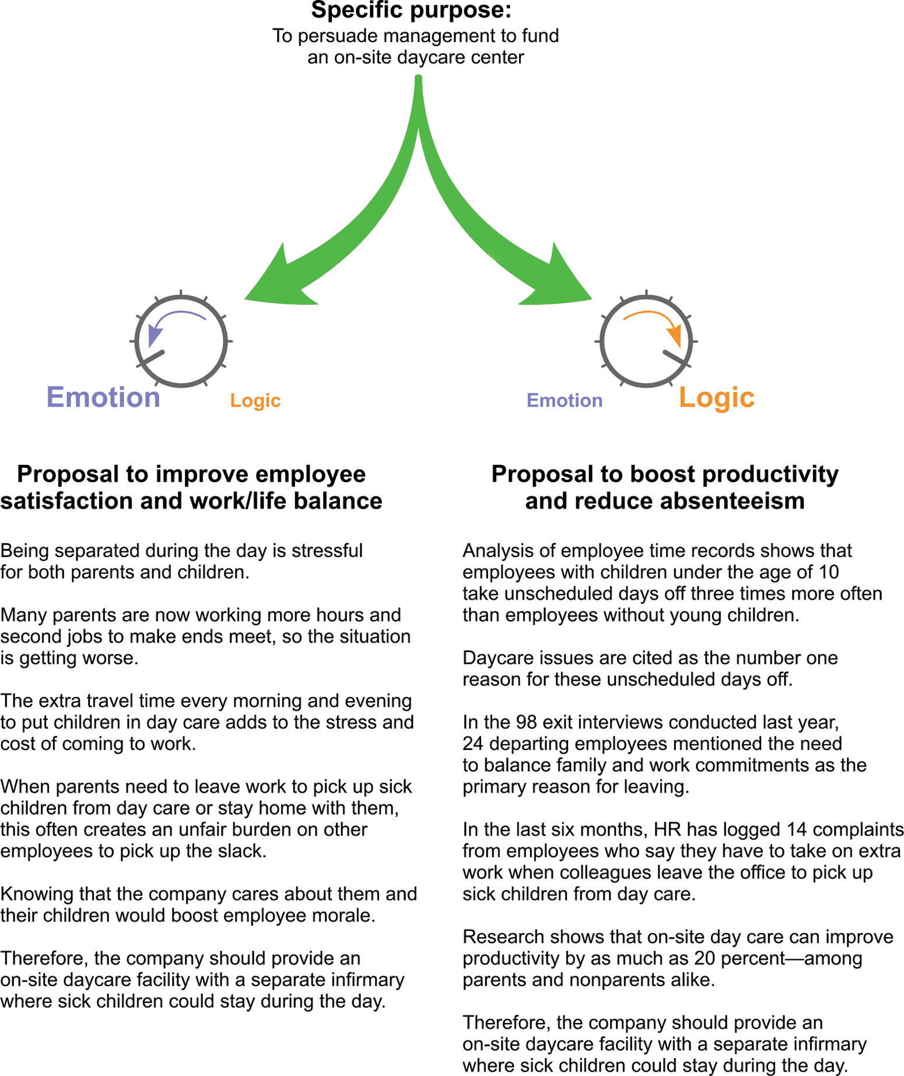
Balancing Emotional and Logical Appeals (2 of 2)
Notes:
Figure 10.3 Balancing Logical and Emotional Appeals
Whenever you plan a persuasive message, imagine you have a knob that turns from emotion at one extreme to logic at the other, letting you adjust the relative proportions of each type of appeal. Compare these two outlines for a proposal that asks management to fund an on-site daycare center. The version on the left relies heavily on emotional appeals, whereas the version on the right uses logical appeals (inductive reasoning, specifically). Through your choice of words, images, and supporting details, you can adjust the emotional/logical ratio in every message.

Slide 15
Avoiding Faulty Logic
Hasty generalizations
Circular reasoning
Attacking an opponent
Oversimplifying a complex issue
Mistaken cause-effect assumptions
Faulty analogies
Notes:
Every method of reasoning is vulnerable to misuse. To avoid faulty logic, follow these guidelines:
Avoid hasty generalizations. Make sure you have plenty of evidence before drawing conclusions.
Avoid circular reasoning. Circular reasoning involves supporting your claim by restating it in different words. The statement “We know temporary workers cannot handle this task because temps are unqualified for it” doesn’t prove anything because the claim and the supporting evidence are essentially identical.
Avoid attacking an opponent. Attack the argument your opponent is making, not your opponent’s character.
Avoid oversimplifying a complex issue. For example, don’t reduce a complex situation to a simple “either/or” statement if the situation isn’t that simple.
Avoid mistaken assumptions of cause and effect. If you can’t isolate the impact of a specific factor, you can’t assume that it’s the cause of whatever effect you’re discussing. You lowered prices, and sales went up. Were lower prices the cause? Maybe, but the sales increase might have been caused by a better advertising campaign, changes in the weather, or some other factor.
Avoid faulty analogies. Be sure that the two objects or situations being compared are similar enough for the analogy to hold. For instance, explaining that an Internet firewall is like a prison wall is a poor analogy, because a firewall keeps things out, whereas a prison wall keeps things in.

Slide 16
Reinforcing Your Position
Believable
Evidence
Powerful
Words
Metaphors
and Stories
Audience
Benefits
Notes:
After you have worked out the basic elements of your argument, step back and look for ways to bolster the strength of your position. Are your claims supported by believable evidence?
Next, examine your language. Can you find more powerful words to convey your message? As with any powerful tool, be sure to use vivid language and abstractions carefully and honestly.
In addition to individual word choices, consider using metaphors and other figures of speech. In a similar way, brief stories (anecdotes) can help your audience grasp the meaning and importance of your arguments.
Beyond the specific wording of your message, look for other forces and factors that can reinforce your position. When you are asking for something, your audience members will find it easier to grant your request if they stand to benefit from it as well.

Slide 17
Anticipating Objections
Counter Negative Elements
Focus on Positive Communication
Present All Sides of the Situation
Notes:
Even the most powerful persuasive messages can expect to encounter some initial resistance. Anticipate as many objections as you can and address them in your initial message before your audience can even bring them up. By doing so, you can remove the potentially negative elements from the conversation and keep the focus on positive communication.
If you expect a hostile audience, one biased against your plan from the beginning, present all sides—cover all options, explaining the pros and cons of each. You’ll gain additional credibility if you present these options before presenting the recommendation or decision. People support what they help create, so involve your audience in the design of the solution, if you can.

Slide 18
Avoiding Common Mistakes in Persuasive Communication
•Using a Hard Sell Approach
•Being Resistant to Compromise
Common Mistakes
•Relying Solely on Great Arguments
•Using a “One-Shot” Approach
Notes:
When you believe in a concept or project, it’s easy to get caught up in your own emotions and forget to see things from the perspective of your audience. When putting together persuasive arguments, avoid common mistakes such as the following:
Using a hard sell. Don’t push. No one likes being pressured into making a decision. In contrast, a “soft sell” is more like a comfortable conversation that uses calm, rational persuasion.
Resisting compromise. Persuasion is a process of give and take. A persuader rarely changes another person’s behavior or viewpoint without altering his or her own views in the process.
Relying solely on great arguments. Great arguments matter, but they are only one part of the equation. Connecting with your audience on the right emotional level, and communicating through vivid language are all just as important; they bring your argument to life.
Assuming persuasion is a one-shot effort. Persuasion is a process, not a one-time event. More often than not, persuasion involves listening to others, testing a position, developing a new position, more testing, more compromise, and so on.

Slide 19
Common Categories of Persuasive Messages
Requests for Action
Presentation of Ideas
Claims and Requests for Adjustment
Notes:
Throughout your career, you’ll have numerous opportunities to write persuasive messages within your organization. In addition, many of the routine requests you studied in Chapter 8 can become persuasive messages, if you want a non-routine result or believe that you haven’t received fair treatment. Most of these messages can be divided into persuasive requests for action, persuasive presentations of ideas, and persuasive claims and requests for adjustment.

Slide 20
Persuasive Requests for Action
Direct Approach to Persuasion
Indirect Approach to Persuasion
Anticipated Request
Unanticipated Request
Notes:
The bulk of your persuasive business messages will involve requests for action. In some cases, your request will be anticipated, so the direct approach is fine. In others, you’ll need to introduce your intention indirectly, and the AIDA model or a similar approach is ideal for this purpose.

Slide 21
Persuasive Presentation of Ideas
Consider a New Idea
Changing
Attitudes or
Beliefs About
a Topic
Reexamine Opinions
Reconsider Ways of Thinking
Notes:
You may encounter situations in which you simply want to change attitudes or beliefs about a particular topic, without asking the audience to decide or do anything—at least not yet. The goal of your first message might be nothing more than encouraging your audience to consider a new idea, reexamine long-held opinions, or to admit to the possibility of new ways of thinking.

Slide 22
Persuasive Claims and Requests for Adjustment
Review the Facts in a Positive Tone
Outline the Problem and Its Status
Give Reasons for Granting the Claim
Close on a Respectful Note
Notes:
Most claims are routine messages and use the direct approach. However, consumers and business professionals sometimes encounter situations in which they believe they haven’t received a fair deal by following normal procedures. These situations require a more persuasive message.
The key ingredients of a good persuasive claim are a complete and specific review of the facts, and a confident and positive tone based on your right to be satisfied with every transaction.
Begin persuasive claims by outlining the problem and continue by reviewing what has been done about it so far, if anything. Be clear, calm, and complete when presenting your case. Be specific about how you would like to see the situation resolved.
Next, give your reader a good reason for granting your claim. Show how the individual or organization is responsible for the problem, and appeal to your reader’s sense of fair play, goodwill, or moral responsibility. Explain how you feel about the problem, but don’t get carried away and don’t make threats. People generally respond most favorably to requests that are calm and reasonable.
Close on a respectful note that reflects how a successful resolution of the situation will repair or maintain a mutually beneficial working relationship.

Slide 23
Developing Marketing and Sales Messages
Describe an effective strategy for developing marketing and sales messages, and explain how to modify your approach when writing promotional messages for social media.
Notes:
Marketing and sales messages use the same techniques as other persuasive messages, with the added emphasis of encouraging someone to participate in a commercial transaction.
Marketing messages usher potential buyers through the purchasing process without asking them to make an immediate decision; that’s when sales messages take over, encouraging potential buyers to make a purchase decision then and there.

Slide 24
Planning Marketing and Sales Messages
Audience
Needs
Competition
Selling Points
and Benefits
Purchase
Objections
Notes:
Successful marketing and sales messages start with an understanding of audience needs. Depending on the product and the market, these needs can range from a few functional considerations to a complicated mix of logical and emotional issues.
Marketing and sales messages are in competition with messages from other companies that are intended for the same audience. Finding a unique message in crowded markets can be challenging.
With insight into audience needs and competitive offerings, the next step is to decide which features and benefits to highlight. Selling points are the most attractive features of an idea or product. Benefits are the particular advantages that users will realize from those features. Selling points focus on what the product does. Benefits focus on what the user experiences or gains.
Marketing and sales messages often encounter objections. As with persuasive business messages, it’s best to identify them up front and try to address as many as you can. Of course, any attempts to minimize perceptions of price or other potential negatives must be done ethically.

Slide 25
Writing Conventional Marketing and Sales Messages
Getting Attention
Building Interest
Increasing Desire
Motivating Action
Using the AIDA Model
Notes:
Most marketing and sales messages are prepared according to the AIDA plan, or some variation of it. Here are the key points of using the AIDA model:
Advertisers try to get attention by offering an exciting product benefit, a piece of interesting news, an appeal to people’s emotions or sense of financial value, or a unique solution to a common problem. Marketers can also use evocative images, music, animation, or video.
After catching the reader’s or viewer’s attention, your next step is to build interest in the product, company, or idea you are promoting. A common technique is to “pay off” the promise made in the headline by explaining how you can deliver those benefits.
Next, boost the audience’s desire for your product or service by expanding on how it will benefit them. Focus on their practical and emotional needs; then, explain how your product or service will meet those needs. And address their potential objections and doubts with demonstrations, testimonials, and money-back guarantees.
The final step in the AIDA model is persuading the audience to take action, such as placing an order by phone or online. The keys to a successful call to action are making it as easy and risk-free as possible. If the process is confusing or time-consuming, you’ll lose potential customers.

Slide 26
Writing Promotional Messages for Social Media
Get Involved in Online Conversations
Listen as Much as You Talk
Initiate and Respond to Conversations
Be Authentic, Transparent, and Real
Notes:
The AIDA model and similar approaches have been successful with marketing and sales messages for decades, but in the social media landscape, consumers are more apt to look for product information from other consumers, not the companies marketing those products. The following guidelines will help you write effective promotional messages for social media.
Get involved in online conversations. Your emphasis should shift to encouraging and participating in online conversations.
Facilitate community building. Make sure customers and other audiences can connect with your company and each other. Accomplishing this goal can be as simple as activating the commenting feature on a blog, or it may involve having a more elaborate social commerce system.
Listen at least as much as you talk. Listening is essential for online conversations, just as it is for in-person conversations. A variety of tools can help, from free alerts on search engines to sophisticated linguistic monitoring systems.
Initiate and respond to conversations within the community. Make sure you provide the information customers need. Use an objective, conversational style; people in social networks want useful information, not “advertising speak.”
Provide information that people want. Whether it’s industry-insider news, product guides, or brief answers to FAQs, fill the information gap about your company and its products.
Identify and support your champions. In marketing, champions are enthusiastic fans of your company and its products. They help spread your message, defend you against detractors, and help other customers use your products.
Be authentic; be transparent; be real. Social media audiences respond poorly to fake blogs and superficial attempts to be “social.” Instead, they respond positively to companies that are open and conversational about themselves, their products, and subjects of shared interest.
Integrate conventional marketing and sales strategies at the right time and in the right places. The AIDA approach is still valid for specific communication tasks, such as conventional advertising and the product promotion pages on your website.

Slide 27
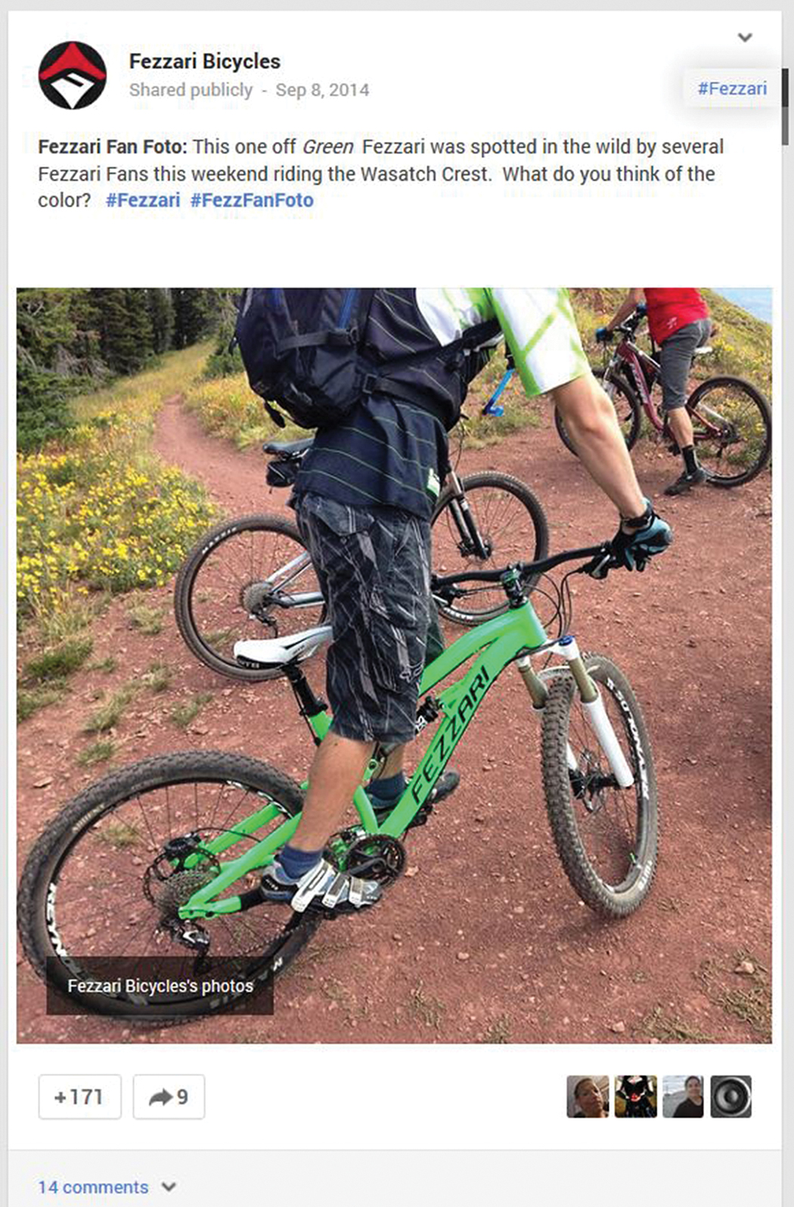
Promotional Messages in Social Media
Notes:
Figure 10.6 Promotional Messages in Social Media
Persuasive communication on social media often avoids overt promotion and instead tries to engage the target audience, as Fezzari Bicycles did with this post on Google+.

Slide 28
Creating Promotional Messages for Mobile Devices
Promotional Messages
Keep Promotional Messages Short and Simple
The Mobile Experience
Keep the Mobile Experience Fast and Straightforward
Notes:
Mobile advertising and mobile commerce (also known as m-commerce) are two of the hottest developments in marketing communications. Companies are pursuing mobile marketing because mobile devices now play such a big role in consumer buying behavior.
If you are involved with creating mobile marketing or sales messages, keep two essential points in mind. First, like all mobile messages, promotional messages need to be kept short and simple. Second, the mobile experience needs to be fast and straightforward. Mobile users are often time-constrained, and they will quickly abandon websites that don’t load quickly or are confusing to navigate.

Slide 29
Avoiding Ethical Lapses in Marketing and Sales Messages
Identify steps you can take to avoid ethical lapses in marketing and sales messages.

Slide 30
Maintaining High Ethical and Legal Standards
Using Persuasion as a Positive Force
Maintaining the “You Attitude” During All Business Transactions
Understanding Legal Aspects of Promotional Communication
Notes:
The word persuasion has negative connotations for some people, especially in a marketing or sales context. However, effective businesspeople view persuasion as a positive force, aligning their own interests with what is best for their audiences, and giving them the freedom to choose. To maintain the highest standards of business ethics, demonstrate the “you attitude” by showing honest concern for the needs and interests of your audience.
As marketing and selling grow increasingly complex, so do the legal ramifications of marketing and sales messages. In the United States, the Federal Trade Commission (FTC) has the authority to impose penalties against advertisers who violate federal standards for truthful advertising. Therefore, all marketers must understand the basic legal aspects of promotional communication.

Slide 31
Basic Legal Aspects of Promotional Communication (1 of 2)
•Be Truthful and Non-Deceptive
•Support Your Claims with Evidence
•Don’t Use Bait-and-Switch Tactics
Notes:
All marketers need to understand these basic legal aspects of promotional communication:
Marketing and sales messages must be truthful and not deceptive.
Your claims must be supported by evidence.
“Bait and switch” advertising is illegal.

Slide 32
Basic Legal Aspects of Promotional Communication (2 of 2)
•Obey Laws When Marketing to Minors
•Observe Contractual Obligations
•Respect the Rights of Individuals
Notes:
Marketing messages and websites aimed at children and minors are subject to special rules.
Marketing and sales messages are considered binding contracts in many states.
In most cases, you can’t use a person’s name, photograph, or other form of identity without permission.
Before launching a marketing or sales campaign, marketers must also be up to date on the latest regulations affecting spam, customer privacy, and data security.

